Slide 1



Slide 2

Team Members
Ahmed Salah Ibrahim
Ahmed Mohamed Ahmed
Khaled Gamal El-Sayed
Yasmeen Khaled Kotb
Ziad Ahmed Abdel-Nour
Omar Essam El-Deen
Shadan Khaled Ibrahim
Ahmed Ehab Ali

Slide 3
Supervised By
Dr. Esraa M. El-hariri
Dr. Asmaa Hashem
‹#›

Slide 4
Table Of Content
01
02
03
04
05
Introduction
Problem Definition
Objectives
Related Work
Proposed System
06
07
08
09
System Analysis
Implementation
Conclusion
Future Work
‹#›

Slide 5
INTRODUCTION

Slide 6
INTRODUCTION
1-Worldwide, 466 million people are affected by hearing loss, with 34 million being children, making up 6.1% of the total population. These individuals struggle greatly with basic communication.
2. To solve the issue of communication barriers, sign language was created as a new form of communication. Although it was a good solution, it was still difficult for others to understand.
3- In this case we just need a TRANSLATOR

Slide 7
PROBLEM DEFINITION

Slide 8
PROBLEM DEFINITION
1- Communication gaps
2-Inaccessible environnements
3. Limited opportunities
4-Social isolation

Slide 9
PROJECT OBJECTIVES

Slide 10
PROJECT OBJECTIVES
1- Developing technology to close the gap between deaf people and hearing people
2- Creating a low-cost software and hardware system design
3- Mobile application that connects to the glove via Bluetooth, allowing them to converse Wirelessly and easily

Slide 11
RELATED WORK

Slide 12
RELATED WORK
Thiago Simões et al. [2023]
-Propose new architecteur (GRU) for Long Short-term memory -The accuracy [96.8%]
Ziad MHD Adib Burhani, et al.[2023] -Propose smart gloves for recognizing the English Alphabet -Best accuracy [95%] worst accuracy [60%]
Haitham Elwahsh, et al.[2022] -Smart Glove and an app that provides speech and text to voiceless people based on Deep Learning (IDLG) -The accuracy [96.5%]
Muhammad Saad, et al.[2022] -American Sign-language recognition using Neural Networks and deep learning -The accuracy for digits [96.5%], for alphabet [90.7%], and for Alphanumeric [91.5%]

Slide 13
PROPOSED SYSTEM

Slide 14


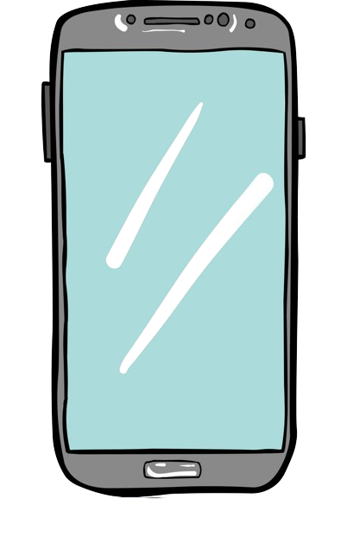
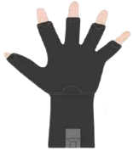
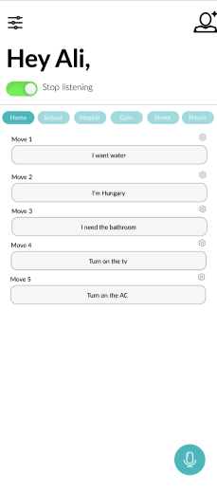
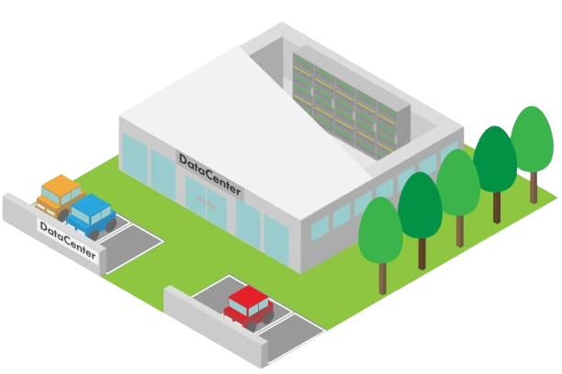
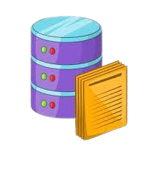
Data Processing System
Database
Server

Slide 15
System Analysis

Slide 16
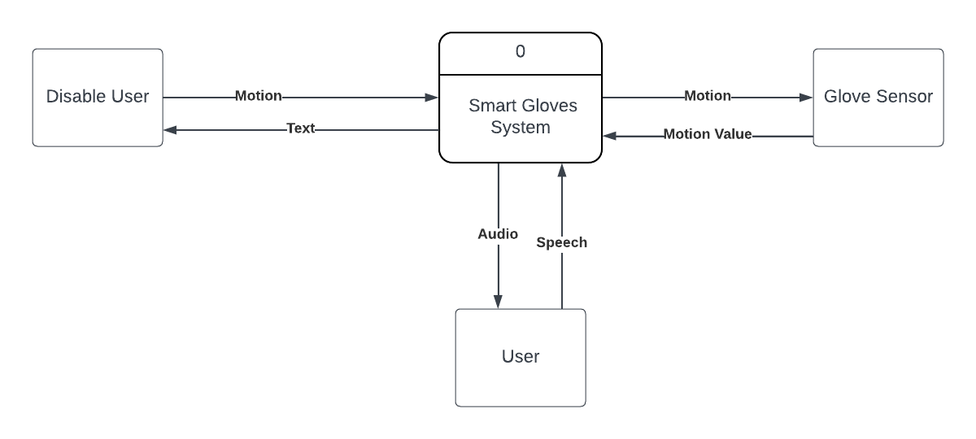
Context Free Diagram

Slide 17
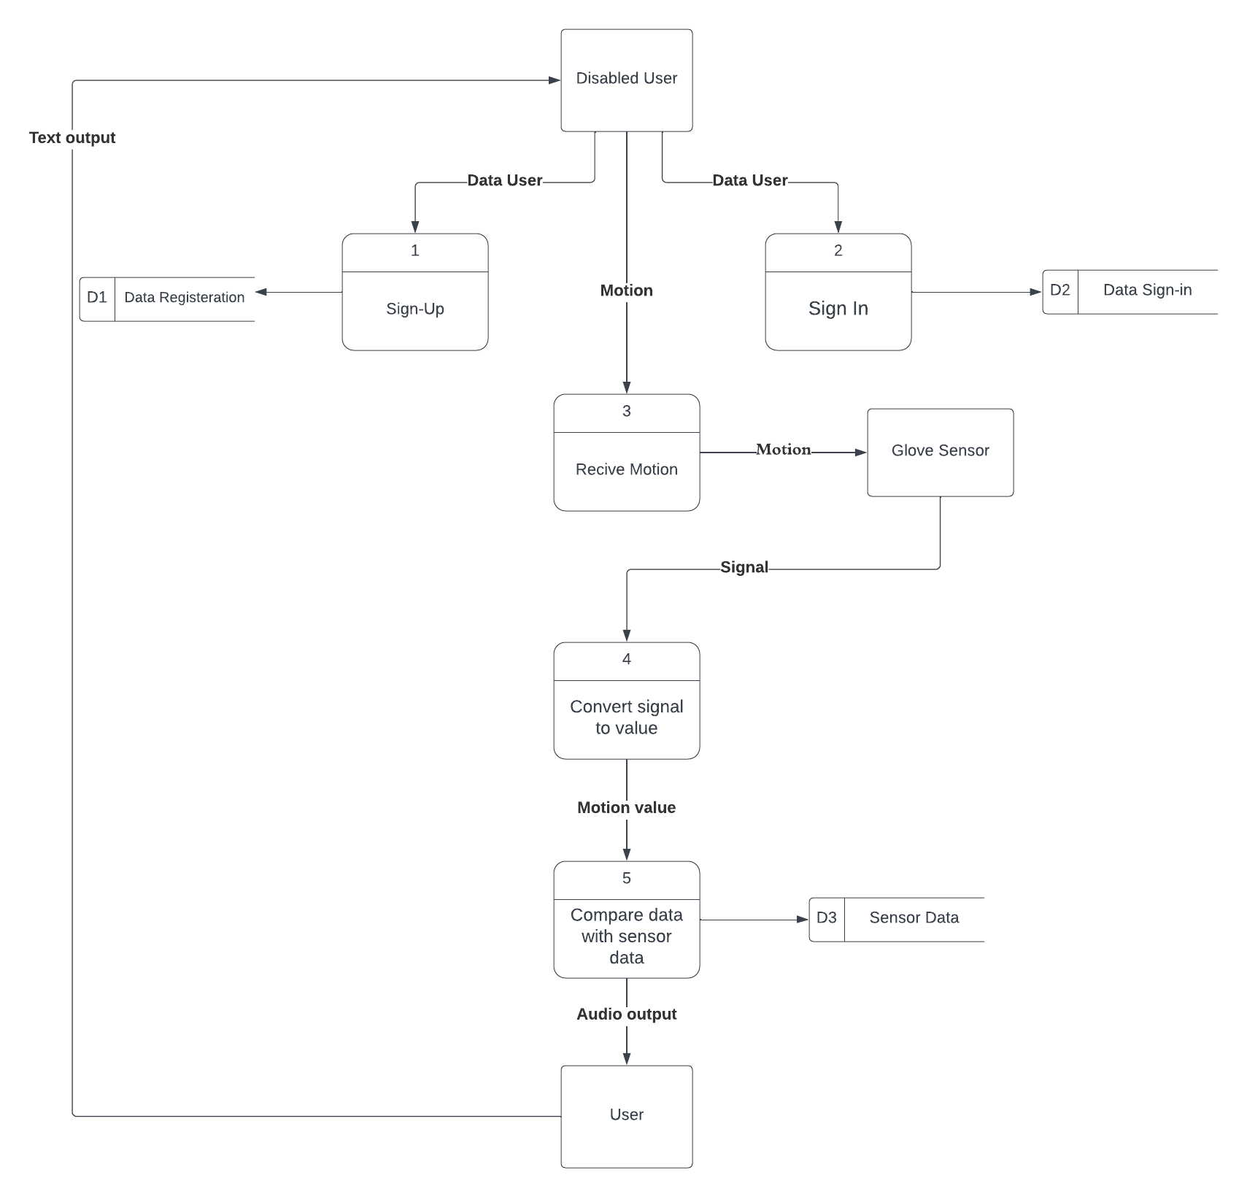
Data Flow Diagram

Slide 18
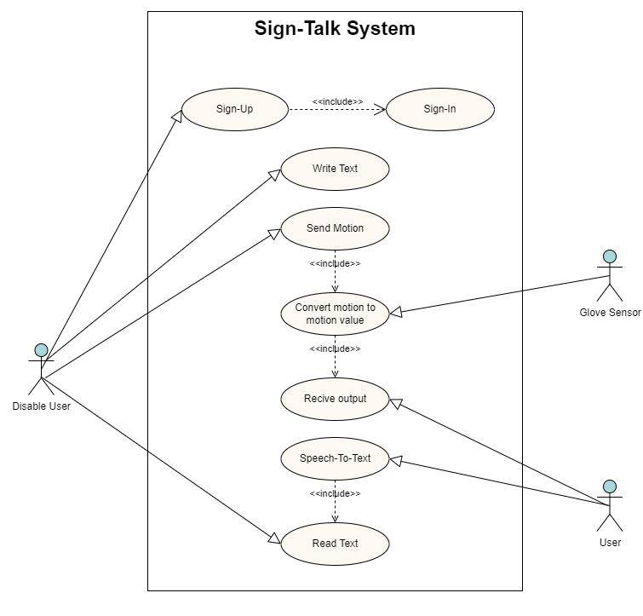
Use Case

Slide 19
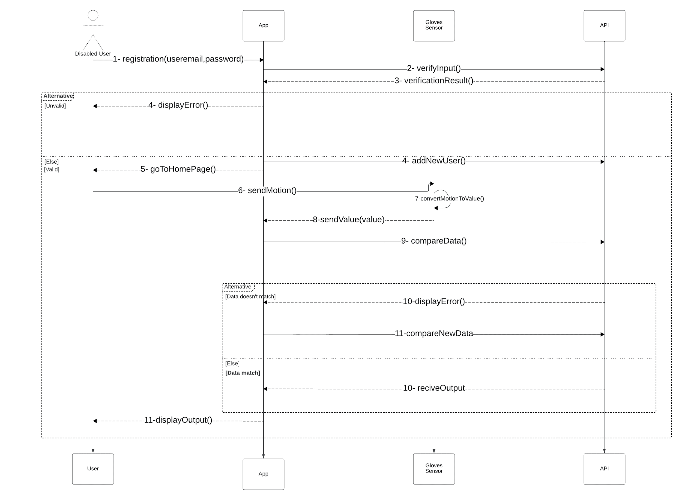
Sequence Diagram
Part-1

Slide 20
Sequence Diagram
Part-2

Slide 21
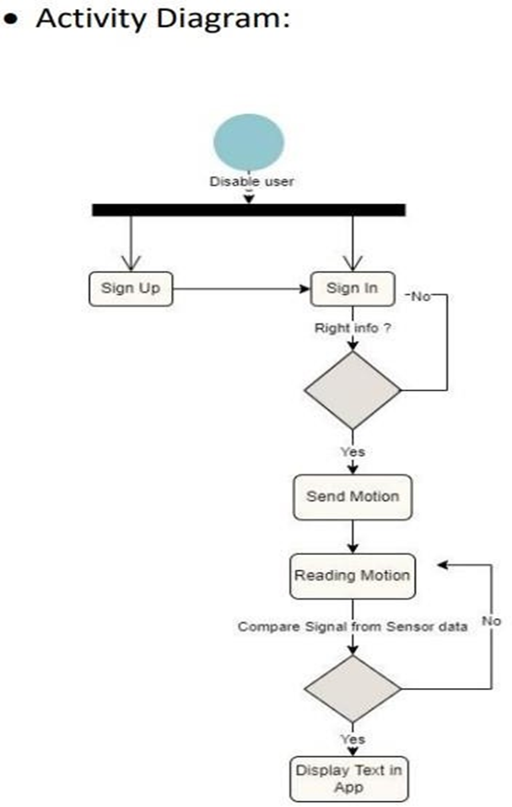
Activity Diagram

Slide 22
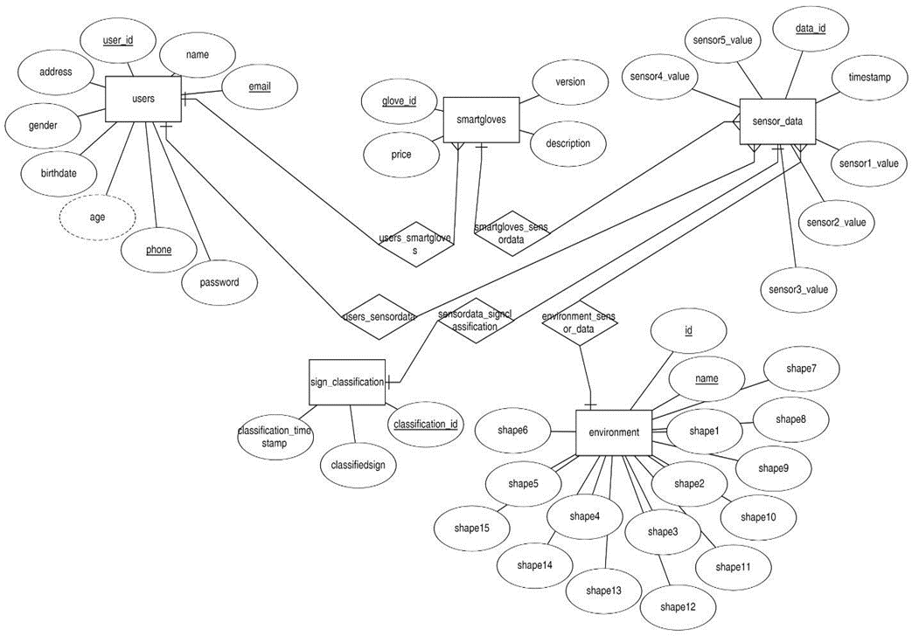
ERD

Slide 23
IMPLEMENTATION

Slide 24
Relation Schema

Slide 25
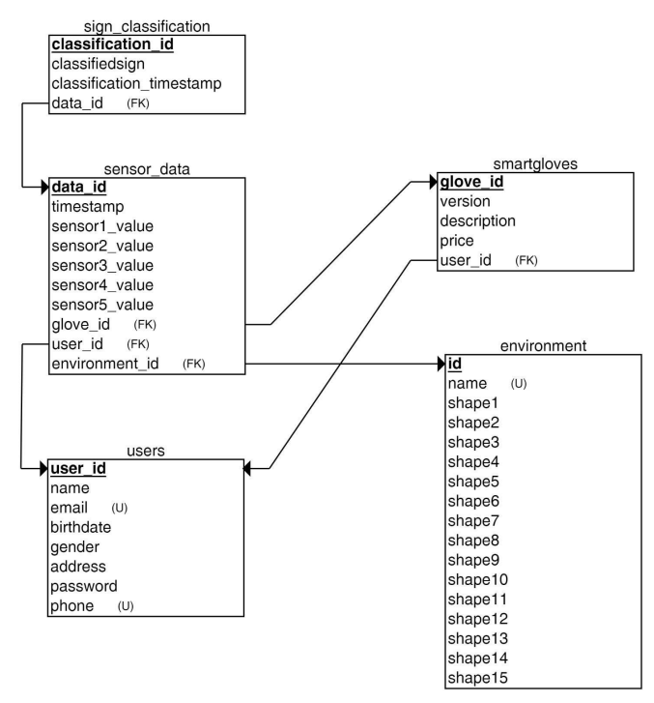
Relation Schema

Slide 26
Mobile App

Slide 27
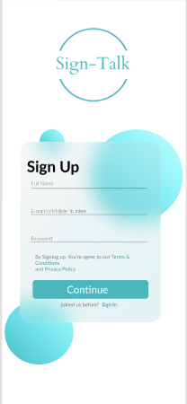
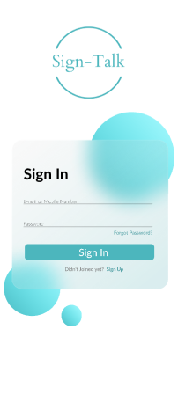
Mobile App
Registeration

Slide 28
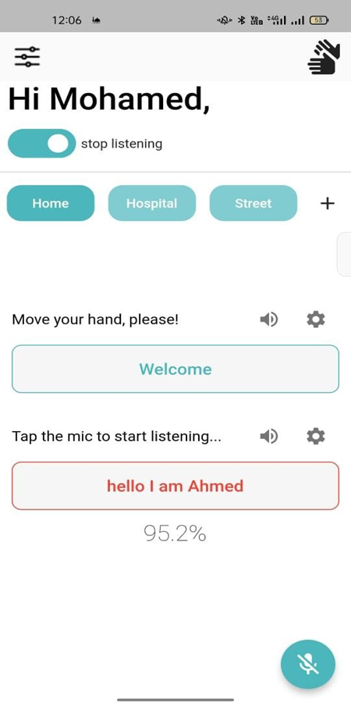
Mobile App
Home Page

Slide 29
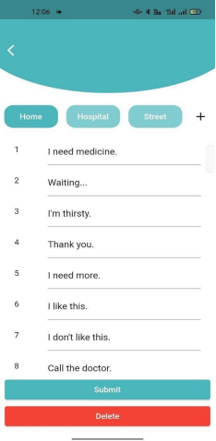
Mobile App
Mode-Section

Slide 30
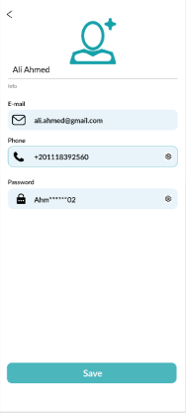
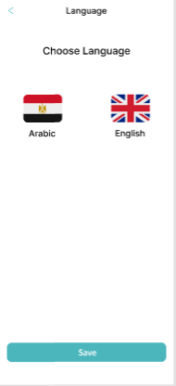
Mobile App
Setting Screens

Slide 31
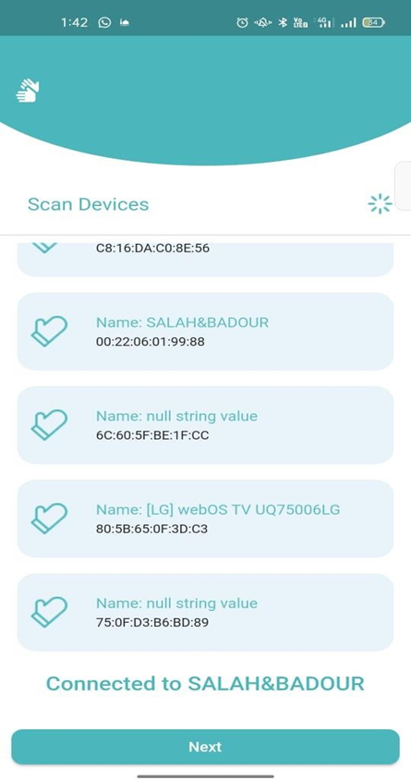
Mobile App
Bluetooth-connction

Slide 32
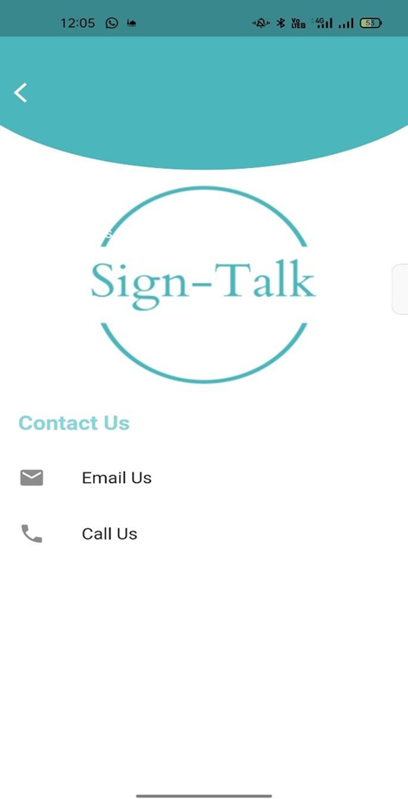
Mobile App
Help-Center

Slide 33
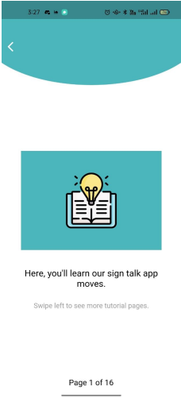
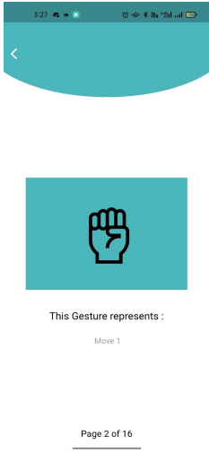
Mobile App
Tutorial

Slide 34
EMBEDDED SYSTEM

Slide 35
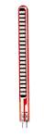
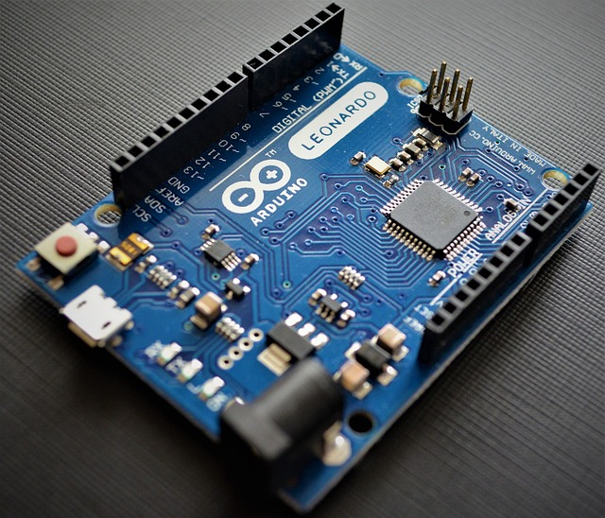
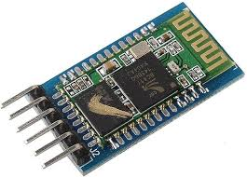
EMBEDDED SYSTEM
1- Arduino uno
2- Flex sensor
3- HC-05 Bluetooth module

Slide 36
Back-End & ML

Slide 37

Back-End & ML
This project is a REST API backend developed using ASP.NET Core 7. It provides APIs for user authentication and management, data storage, and other core functionality.
Developed in C# using ASP.NET Core 7 framework.
Provides robust and scalable APIs for Smart Glove functionalities.
Ensures seamless data communication and efficient data processing.

Slide 38
Back-End & ML
Technology Stack
C# using ASP.NET Core 7 framework:
A high-performance, cross-platform framework ideal for building robust and scalable solutions.
Entity Framework Core:
A powerful ORM for data access, providing type safety and efficient data processing.
SQL Server:
A reliable and efficient database management system.
ML.NET:
A machine learning framework for .NET that allows for integration of machine learning models into our application

Slide 39
Back-End & ML
API Architecture
Layers of the Application
Presentation Layer: API Controllers
Business Logic Layer: Services
Data Access Layer: Entity Framework Core
Models: Domain Models
Flow of Data
User -> API Controller -> Service -> Database

Slide 40

Machine Learning
ML.NET Integration
ML.NET is a machine learning framework for .NET that we have integrated into our application. The advantages of using ML.NET include:
∙ Flexibility:
Supports a wide range of machine learning tasks including classification, regression, clustering, and more.
∙ Performance:
High-performance framework that can handle large datasets and complex models efficiently.
∙ Ease of Use:
Provides a straightforward API and tooling that simplifies the development and deployment of machine learning models.

Slide 41
Data Set

Slide 42
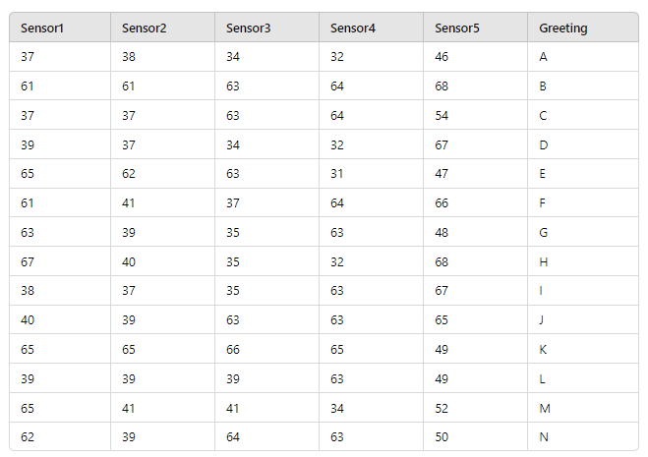
Data Set
Data Model Collecting / Training

Slide 43
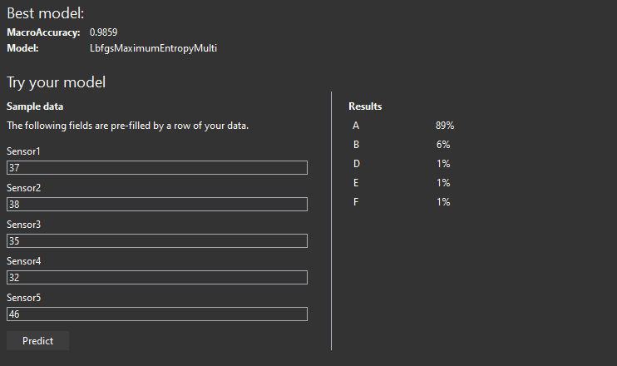
Data Set
Model Testing

Slide 44
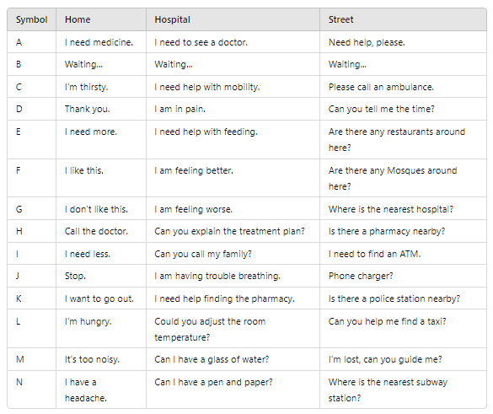
Data Set
Default Modes

Slide 45
CONCLUSION

Slide 46
CONCLUSION
1- The SIGN-TALK smart glove translates sign language into text and speech in real-time using flex sensors, an IMU, and pressure sensors.
2- Advanced machine learning models process the data with 90.1% accuracy, allowing users to choose specific gestures or the full range of sign language.
3- The system improves communication for individuals with hearing and speech impairments, showcasing technical innovation and a commitment to enhancing quality of life.

Slide 47
FUTURE WORK

Slide 48
FUTURE WORK
Part-1
1- Extended Sign Language Coverage: Enhance gesture recognition to include more sign languages, including regional and less common variants.
2- IoT Integration: Connect the smart glove with other IoT devices for a more integrated communication environment.
3- Third-party App Integration: Ensure compatibility with popular communication and productivity apps.
4-Biometric Sensors: Add sensors for health monitoring, including heart rate, skin temperature, and stress levels

Slide 49
FUTURE WORK
Part-2
5- Emergency Alerts: Implement a system to notify caregivers or emergency services during health crises.
6- Multilingual Support: Expand the app's language and dialect support for broader accessibility.
7- User Community: Develop a platform for users to share experiences, tips, and custom gestures.

Slide 50
Thanks

